Slide 1

Credit Card Financial Dashboard
VIKRANT KAWADKAR Manipal University Jaipur

Slide 2

PROBLEM STATEMENT
To develop a comprehensive credit card weekly dashboard that provides real-time insights into key performance metrics and trends, enabling stakeholders to monitor and analyze credit card operations effectively.

Slide 3
Project Description
Credit card financial dashboard using Power BI:
• Developed an interactive dashboard using transaction and customer data from a SQL database, to provide real-time insights.
• Streamlined data processing & analysis to monitor key performance metrics and trends.
• Shared actionable insights with stakeholders based on dashboard findings to support decision-making processes.

Slide 4

WHO ARE THE END USERS?
Management and Executives: C-level executives and business unit managers seeking high-level insights.
Finance and Analytics Teams: Financial analysts, data scientists, and risk managers.
Marketing and Sales Teams: Marketing managers and sales teams leveraging insights.
Customer Service and Support: Representatives handling inquiries and support.
Compliance and Regulatory Teams: Compliance officers and auditors ensuring adherence.

Slide 5

Technology Used
Microsoft Power BI
Microsoft Excel
MY SQL

Slide 6
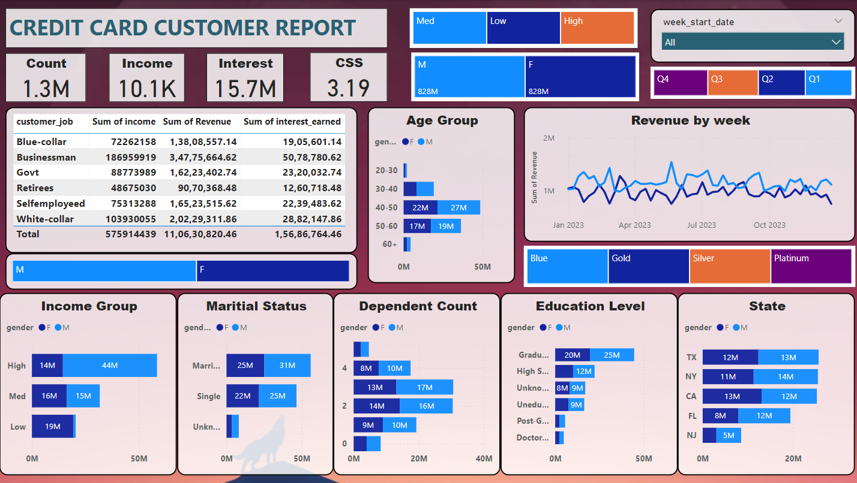
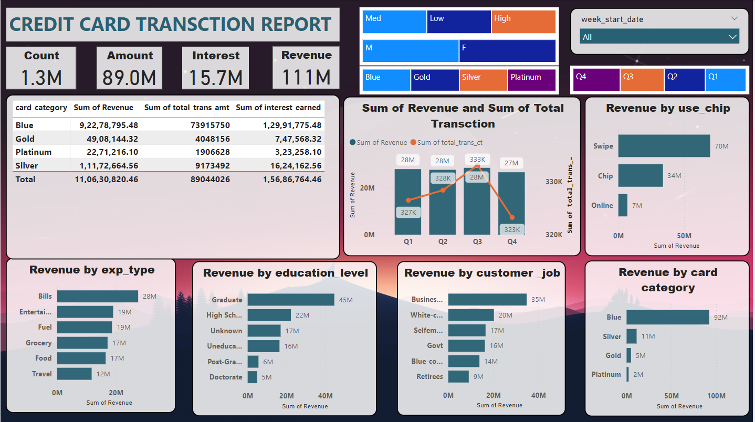
RESULTS
[Add screen shots of your code ]

Slide 7
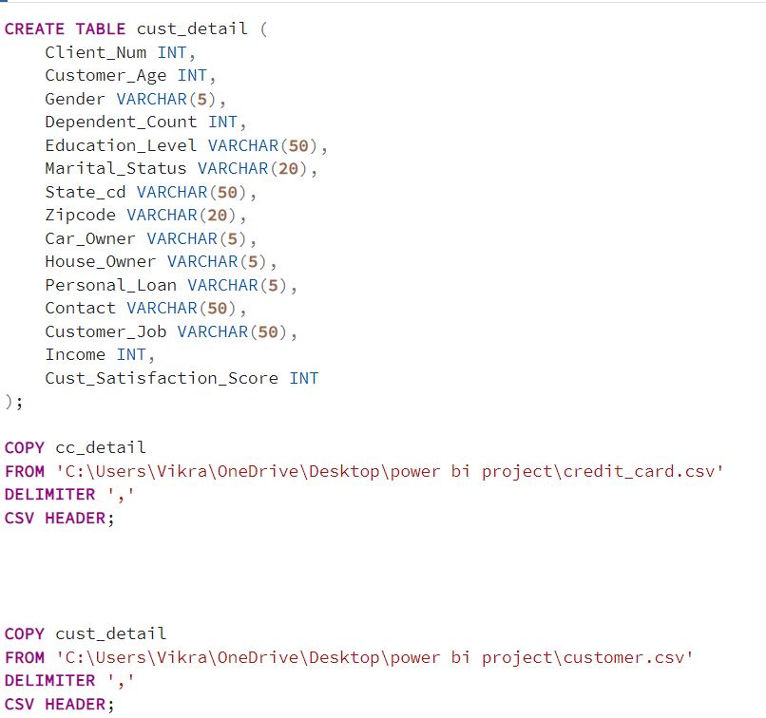
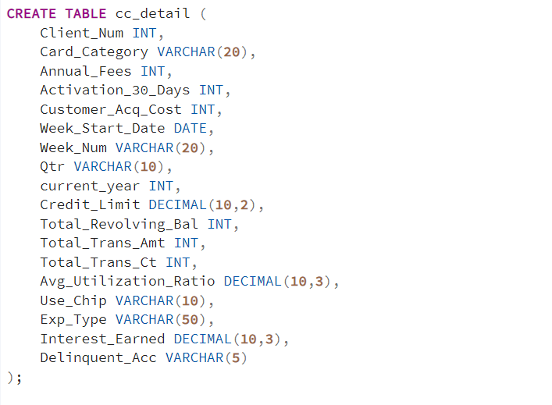

Slide 8
DIY PROJECT LINKS:
Google drive link
https://colab.research.google.com/drive/1bFVe3-Lg8zIF7WZxVHoN_1qrxNNA7awJ?usp=sharing
Link to google colab
https://colab.research.google.com/drive/1bFVe3-Lg8zIF7WZxVHoN_1qrxNNA7awJ?usp=sharing
Screenshot link
https://drive.google.com/drive/folders/1uAP23xa7kFeXbZ0nxuGVBQASagg-3Zg3?usp=sharing

Slide 9
Thank you
.
.

